Slide 1
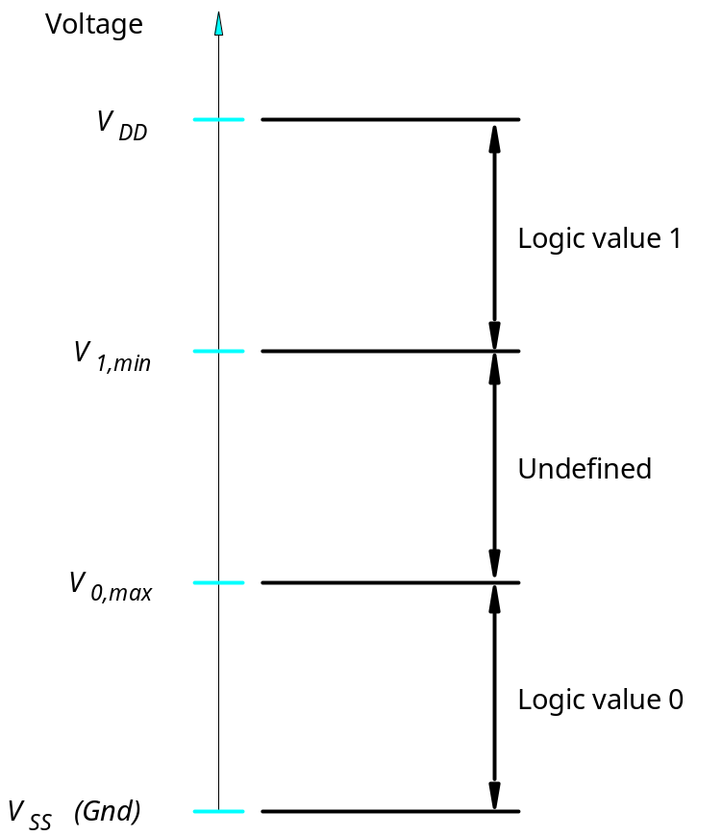
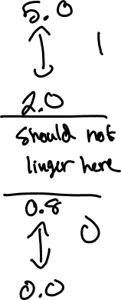
Implementation Technology
Figure 3.1. Logic values as voltage levels.
3 - Implementation Tech
Portions © Copyright 2009, S. Brown and Z Vranesic

Slide 2
x
= "low"
x
= "high"
(a) A simple switch controlled by the input
x
Gate
Source
Drain
Substrate (Body)
(b) NMOS transistor
V
G
V
S
V
D
(c) Simplified symbol for an NMOS transistor
Figure 3.2. NMOS transistor as a switch.
3 - Implementation Tech
Portions © Copyright 2009, S. Brown and Z Vranesic

Slide 3
x
= "high"
x
= "low"
(a) A switch with the opposite behavior of Figure 3.2
a
Gate
Drain
Source
V
DD
Substrate (Body)
(b) PMOS transistor
V
G
V
S
V
D
(c) Simplified symbol for a PMOS transistor
Figure 3.3. PMOS transistor as a switch.
3 - Implementation Tech
Portions © Copyright 2009, S. Brown and Z Vranesic

Slide 4
V
D
V
D
= 0 V
V
D
(a) NMOS transistor
V
G
V
S
= 0 V
Closed switch
Open switch
when
V
G
=
V
DD
when
V
G
= 0 V
V
S
=
V
DD
V
DD
V
DD
(b) PMOS transistor
V
G
V
D
V
D
V
D
=
V
DD
Open switch
Closed switch
when
V
G
=
V
DD
when
V
G
= 0 V
Figure 3.4. NMOS and PMOS transistors in logic circuits.
3 - Implementation Tech
Portions © Copyright 2009, S. Brown and Z Vranesic

Slide 5
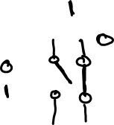
V
DD
R
R
5 V
+
-
V
V
f
f
V
x
V
x
(a) Circuit diagram
(b) Simplified circuit diagram
x
f
x
f
(c) Graphical symbols
Figure 3.5. A NOT gate built using NMOS technology.
3 - Implementation Tech
Portions © Copyright 2009, S. Brown and Z Vranesic

Slide 6
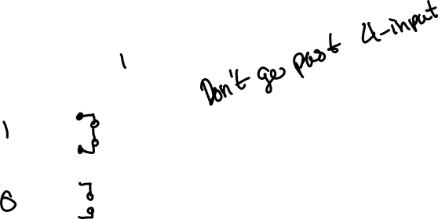
V
DD
V
f
V
x
1
x
1
x
2
f
0
0
1
x
1
x
1
V
x
x
f
x
f
2
0
1
1
2
2
1
0
1
1
1
0
(c) Graphical symbols
(a) Circuit
(b) Truth table
Figure 3.6. NMOS realization of a NAND gate.
3 - Implementation Tech
Portions © Copyright 2009, S. Brown and Z Vranesic

Slide 7
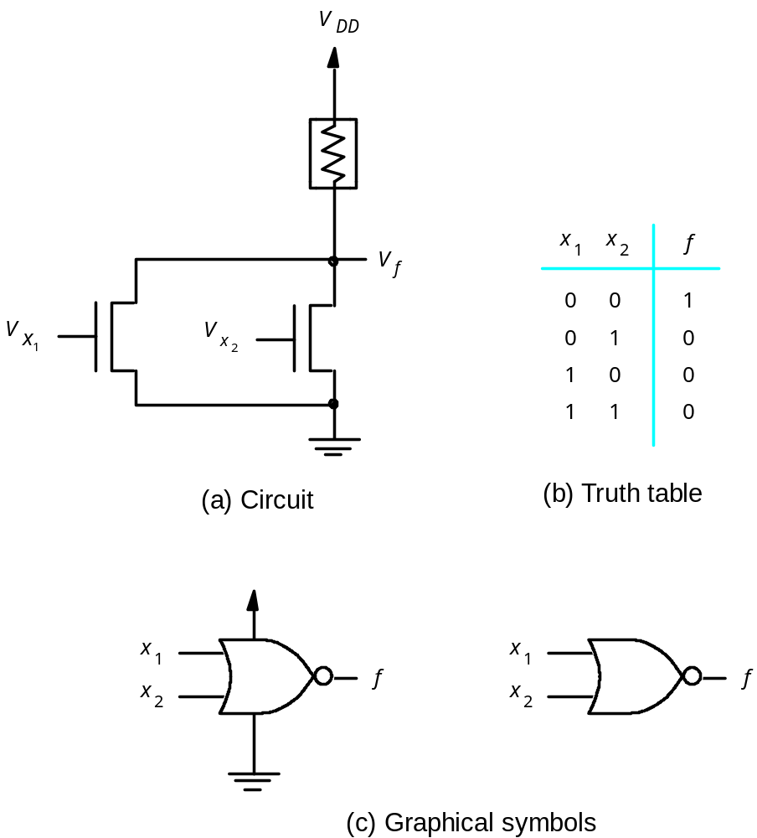

Figure 3.7. NMOS realization of a NOR gate.
3 - Implementation Tech
Portions © Copyright 2009, S. Brown and Z Vranesic

Slide 8

V
DD
V
DD
V
f
A
V
x
1
x
1
x
2
f
V
0
0
0
x
1
x
1
x
x
f
x
f
2
0
1
0
2
2
1
0
0
1
1
1
(a) Circuit
(b) Truth table
(c) Graphical symbols
Figure 3.8. NMOS realization of an AND gate.
3 - Implementation Tech
Portions © Copyright 2009, S. Brown and Z Vranesic

Slide 9

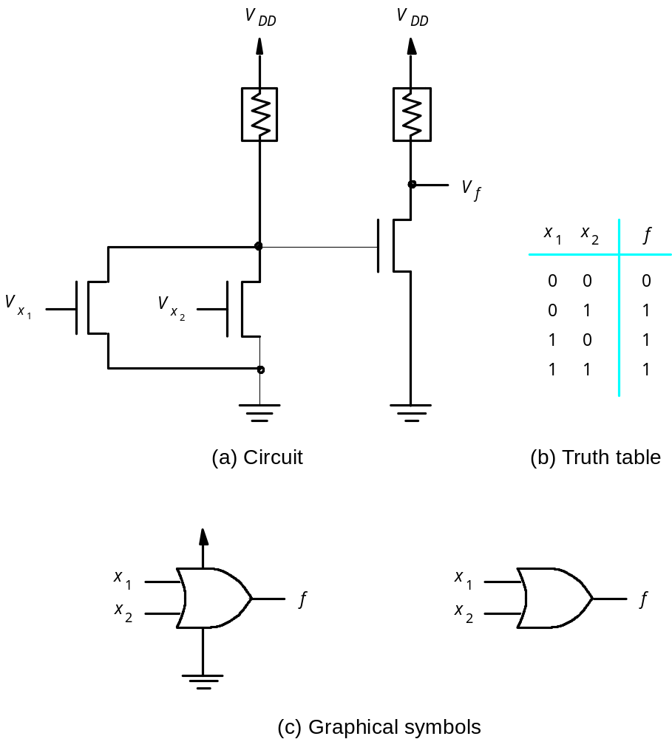
Figure 3.9. NMOS realization of an OR gate.
3 - Implementation Tech
Portions © Copyright 2009, S. Brown and Z Vranesic

Slide 10
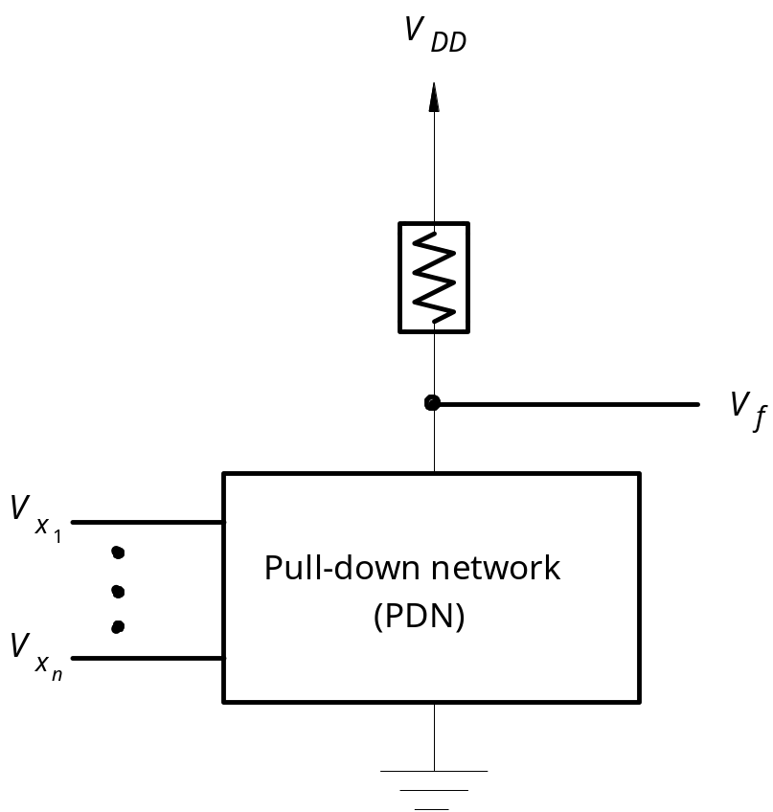
Figure 3.10. Structure of an NMOS circuit.
3 - Implementation Tech
Portions © Copyright 2009, S. Brown and Z Vranesic

Slide 11
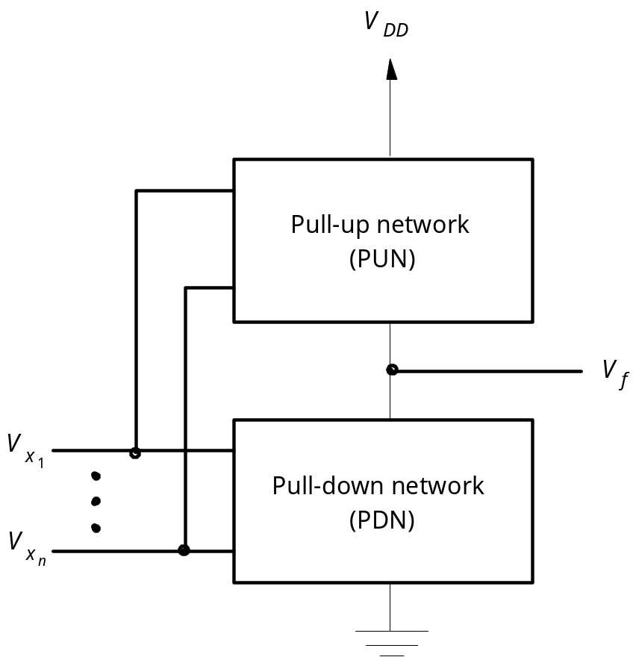

Figure 3.11. Structure of a CMOS circuit.
3 - Implementation Tech
Portions © Copyright 2009, S. Brown and Z Vranesic

Slide 12
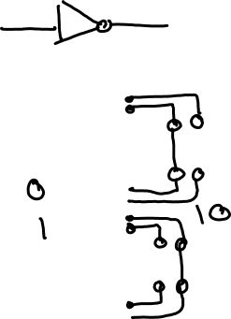
V
DD
T
1
V
x
V
f
x
T
1
T
2
f
T
2
0
on
off
1
1
off
on
0
(a) Circuit
(b) Truth table and transistor states
Figure 3.12. CMOS realization of a NOT gate.
3 - Implementation Tech
Portions © Copyright 2009, S. Brown and Z Vranesic

Slide 13
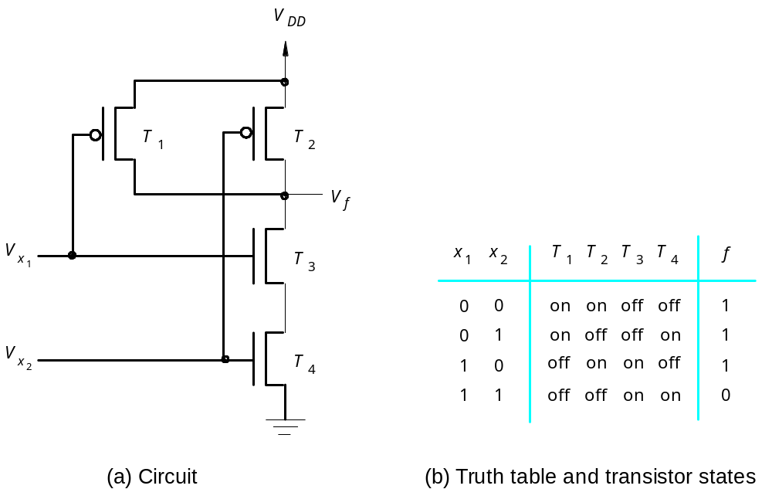

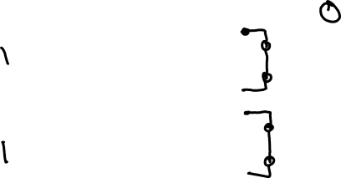
Figure 3.13. CMOS realization of a NAND gate.
3 - Implementation Tech
Portions © Copyright 2009, S. Brown and Z Vranesic

Slide 14
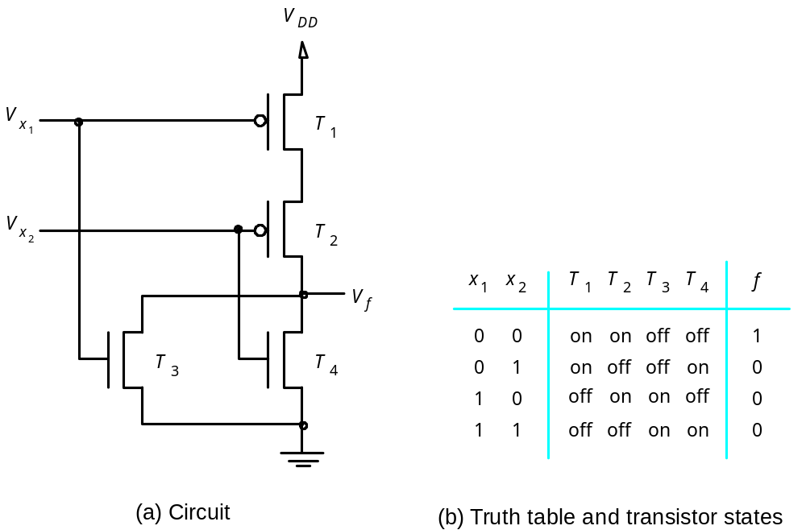
Figure 3.14. CMOS realization of a NOR gate.
3 - Implementation Tech
Portions © Copyright 2009, S. Brown and Z Vranesic

Slide 15
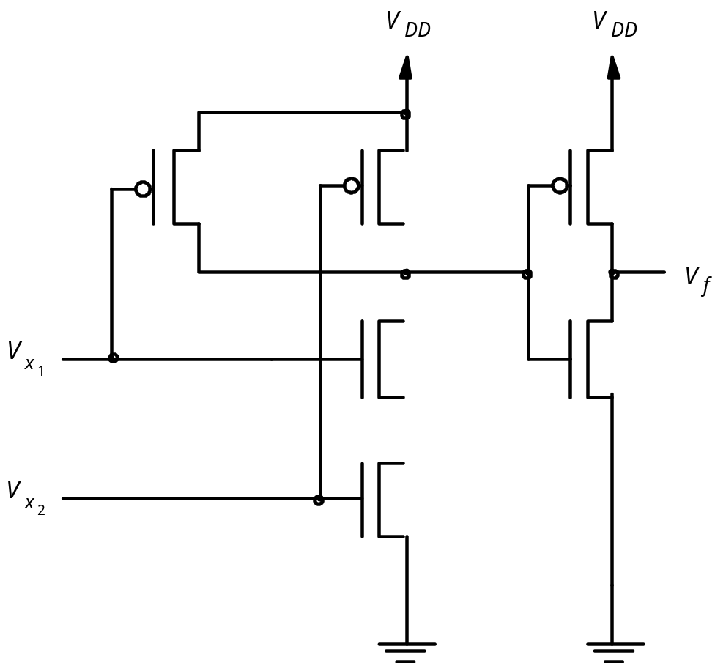
Figure 3.15. CMOS realization of an AND gate.
3 - Implementation Tech
Portions © Copyright 2009, S. Brown and Z Vranesic

Slide 16
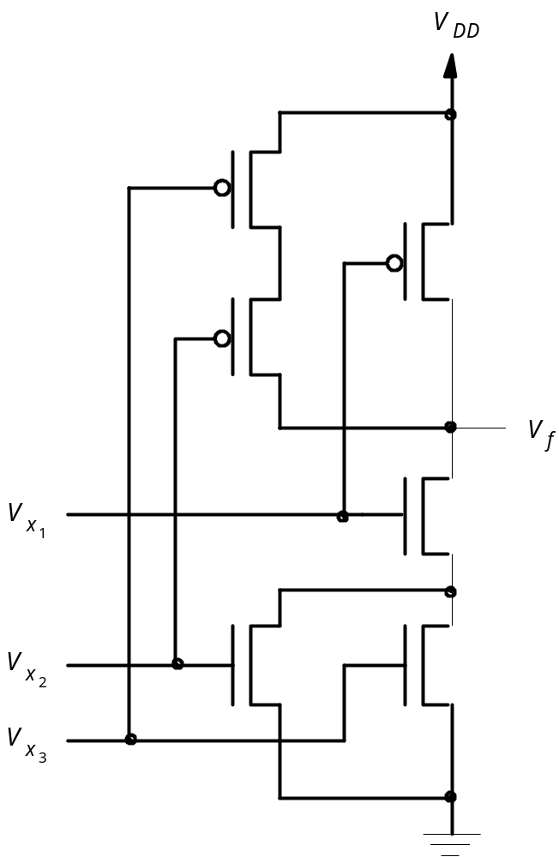
Figure 3.16. The circuit for Example 3.1.
3 - Implementation Tech
Portions © Copyright 2009, S. Brown and Z Vranesic

Slide 17
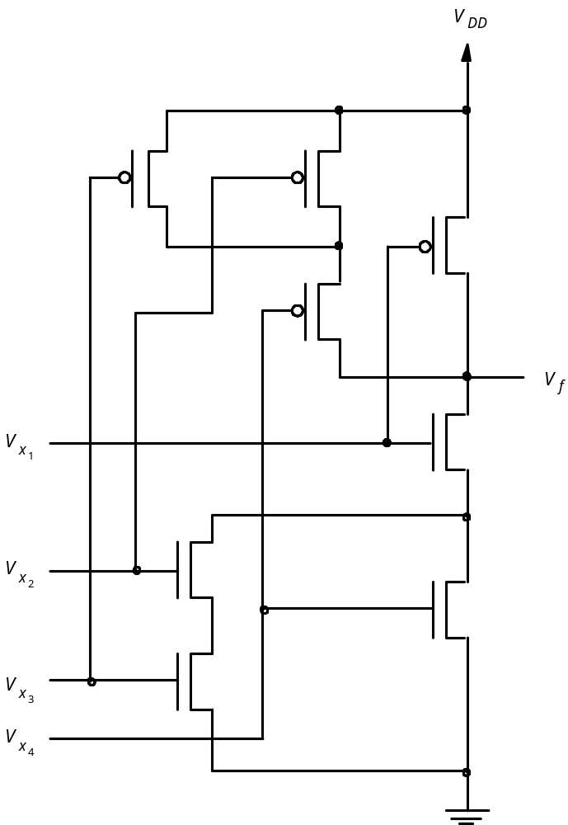
Figure 3.17. The circuit for Example 3.2.
3 - Implementation Tech
Portions © Copyright 2009, S. Brown and Z Vranesic

Slide 18
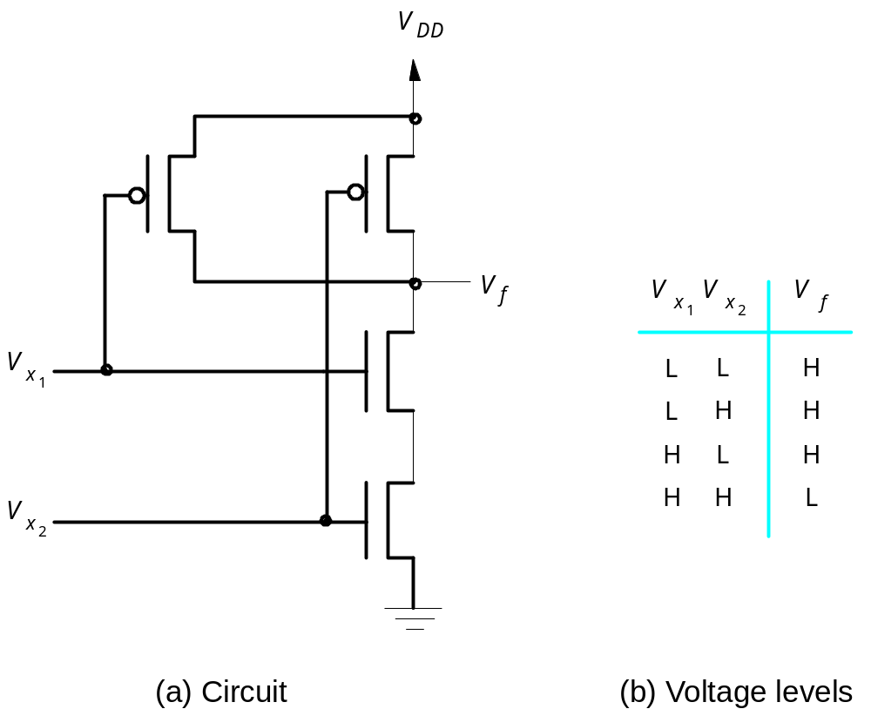
Figure 3.18. Voltage levels in the circuit in Figure 3.13.
3 - Implementation Tech
Portions © Copyright 2009, S. Brown and Z Vranesic

Slide 19
x
1
x
2
f
0
0
1
x
0
1
1
1
f
x
2
1
0
1
1
1
0
(a) Positive logic truth table and gate symbol
x
1
x
2
f
1
1
0
x
1
0
0
1
f
x
2
0
1
0
0
0
1
(b) Negative logic truth table and gate symbol
Figure 3.19. Interpretation of the circuit in Figure 3.18.
3 - Implementation Tech
Portions © Copyright 2009, S. Brown and Z Vranesic

Slide 20
V
x
V
x
V
f
x
1
x
2
f
1
2
L
L
L
0
0
0
x
0
1
0
1
f
L
H
L
x
H
L
L
1
0
0
2
H
H
H
1
1
1
(a) Voltage levels
(b) Positive logic
x
1
x
2
f
1
1
1
x
1
0
1
1
f
x
2
0
1
1
0
0
0
(c) Negative logic
Figure 3.20. Interpretation of the circuit in Figure 3.15.
3 - Implementation Tech
Portions © Copyright 2009, S. Brown and Z Vranesic

Slide 21
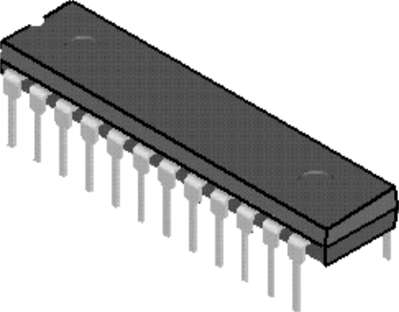
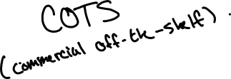
(a) Dual-inline package
V
DD
Gnd
(b) Structure of 7404 chip
Figure 3.21. A 7400-series chip.
3 - Implementation Tech
Portions © Copyright 2009, S. Brown and Z Vranesic

Slide 22
V
DD
7404
7408
7432
x
1
x
2
x
3
f
Figure 3.22. An implementation of f = x₁x₂ + x₂x₃.
3 - Implementation Tech
Portions © Copyright 2009, S. Brown and Z Vranesic

Slide 23

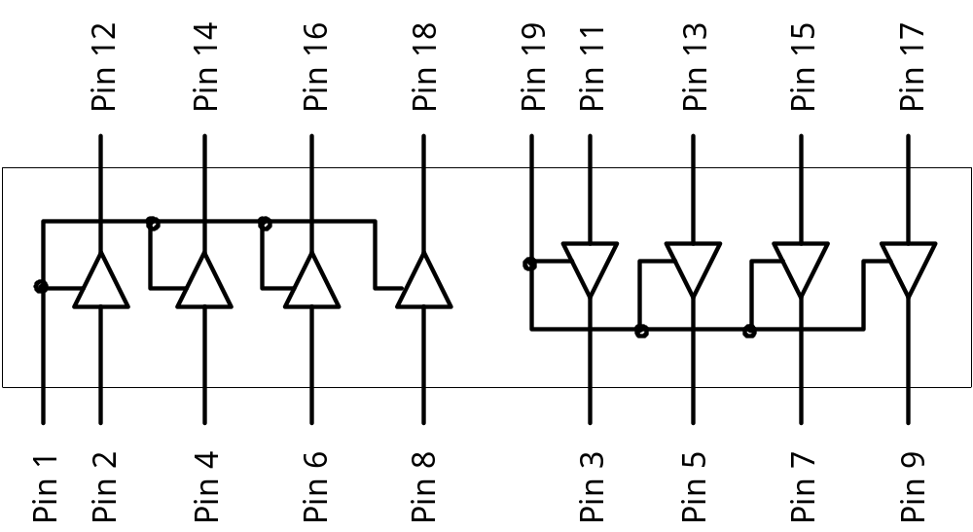
Figure 3.23. The 74244 buffer chip.
3 - Implementation Tech
Portions © Copyright 2009, S. Brown and Z Vranesic

Slide 24
Logic gates
Inputs
and
Outputs
(logic variables)
programmable
(logic functions)
switches
Figure 3.24. Programmable logic device as a black box.
3 - Implementation Tech
Portions © Copyright 2009, S. Brown and Z Vranesic

Slide 25

x
1
x
2
x
n
Input buffers
and
inverters
x
1
x
1
x
n
x
n
P
1
AND plane
OR plane
P
k
f
f
1
m
Figure 3.25. General structure of a PLA.
3 - Implementation Tech
Portions © Copyright 2009, S. Brown and Z Vranesic

Slide 26

x
1
x
2
x
3
Programmable
connections
OR plane
P
1
Figure 3.26. Gate-level diagram of a PLA.
P
2
P
3
P
4
AND plane
3 - Implementation Tech
Portions © Copyright 2009, S. Brown and Z Vranesic
f
1
f
2

Slide 27
x
1
x
2
x
3
OR plane
P
1
P
2
P
3
P
4
AND plane
f
f
1
2
Figure 3.27. Customary schematic for the PLA in Figure 3.26.
3 - Implementation Tech
Portions © Copyright 2009, S. Brown and Z Vranesic

Slide 28
x
1
x
2
x
3
P
1
f
1
P
2
P
3
f
2
P
4
AND plane
Figure 3.28. An example of a PLA.
3 - Implementation Tech
Portions © Copyright 2009, S. Brown and Z Vranesic

Slide 29
Select
Enable
f
1
Flip-flop
D
Q
Clock
To AND plane
Figure 3.29. Extra circuitry added to OR-gate from Figure 3.28.
3 - Implementation Tech
Portions © Copyright 2009, S. Brown and Z Vranesic

Slide 30
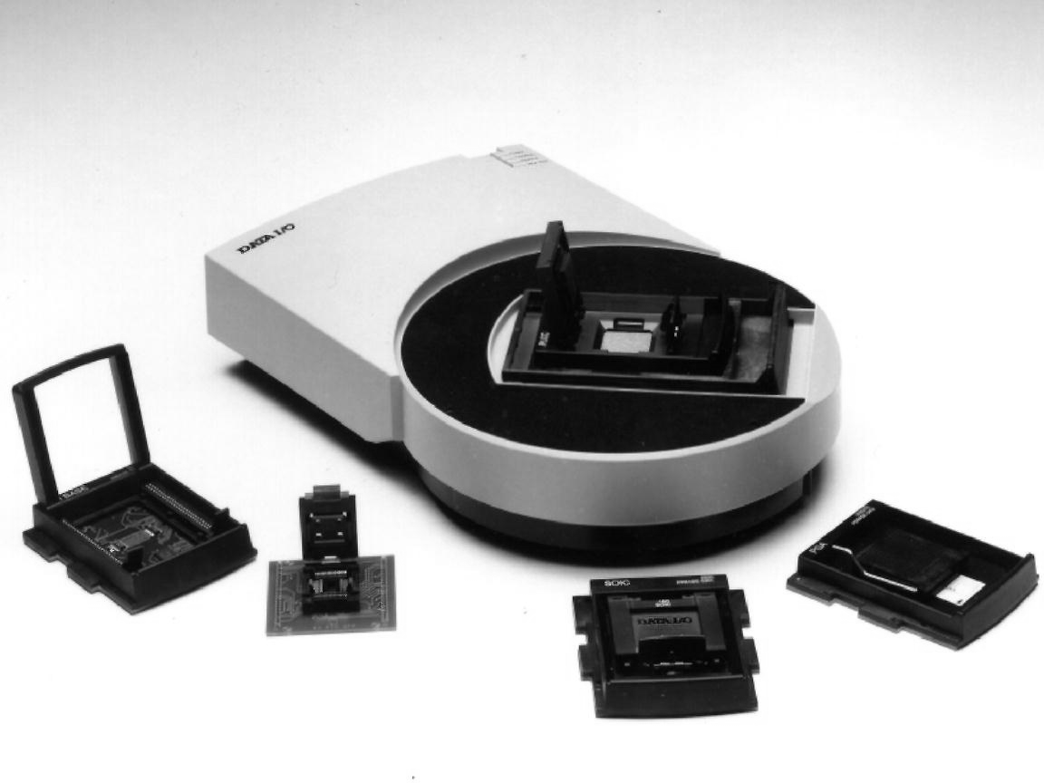
Figure 3.30. A PLD programming unit (courtesy of Data IO Corp).
3 - Implementation Tech
Portions © Copyright 2009, S. Brown and Z Vranesic

Slide 31
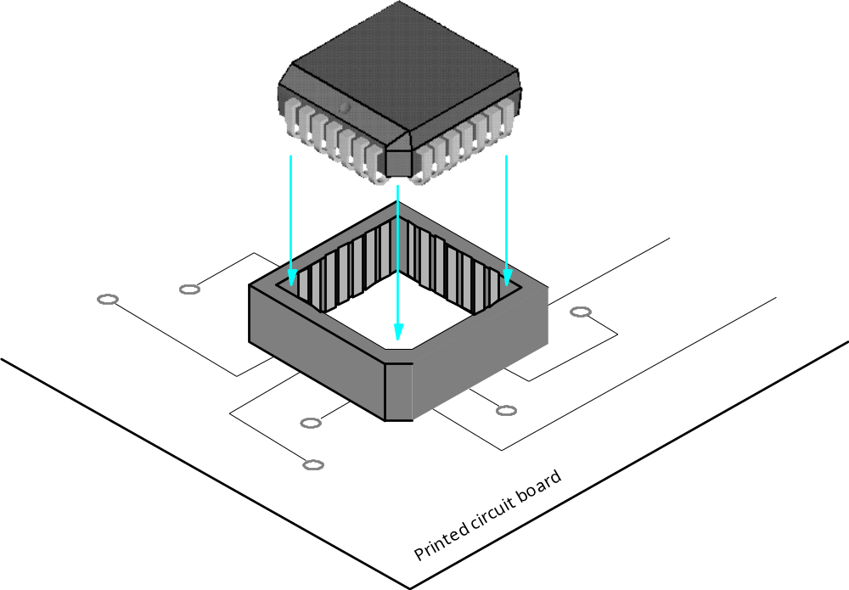
Figure 3.31. A PLCC package with socket.
3 - Implementation Tech
Portions © Copyright 2009, S. Brown and Z Vranesic

Slide 32
I/O block
PAL-like
PAL-like
block
block
I/O block
Interconnection wires
I/O block
PAL-like
PAL-like
block
block
I/O block
Figure 3.32. Structure of a complex programmable logic device (CPLD).
3 - Implementation Tech
Portions © Copyright 2009, S. Brown and Z Vranesic

Slide 33
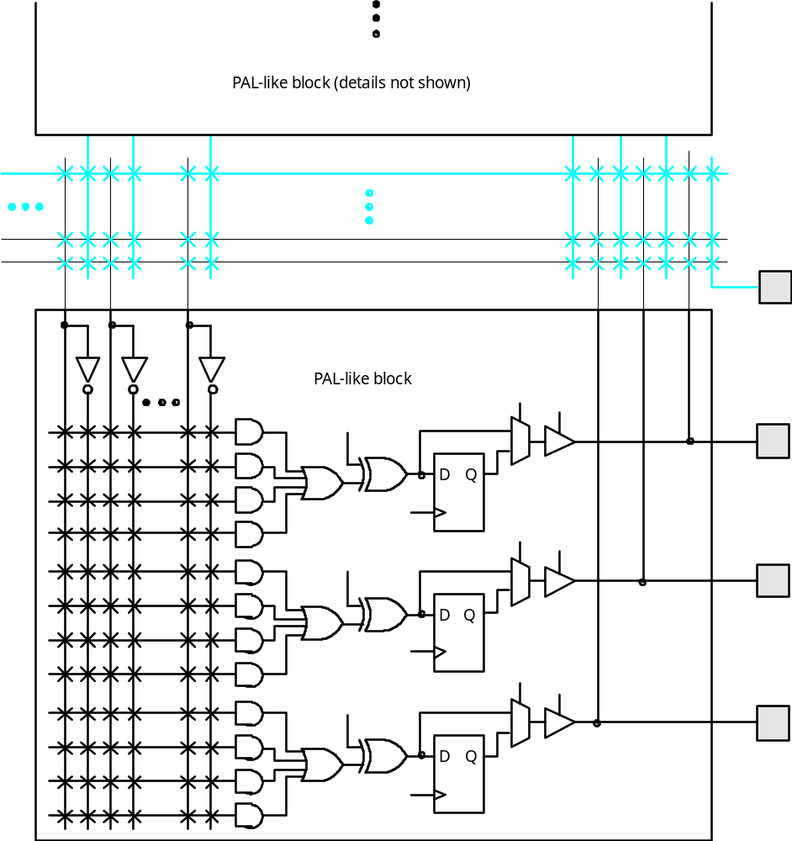
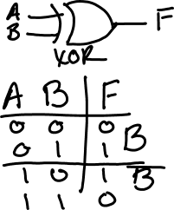
Figure 3.33. A section of the CPLD in Figure 3.32.
3 - Implementation Tech
Portions © Copyright 2009, S. Brown and Z Vranesic

Slide 34
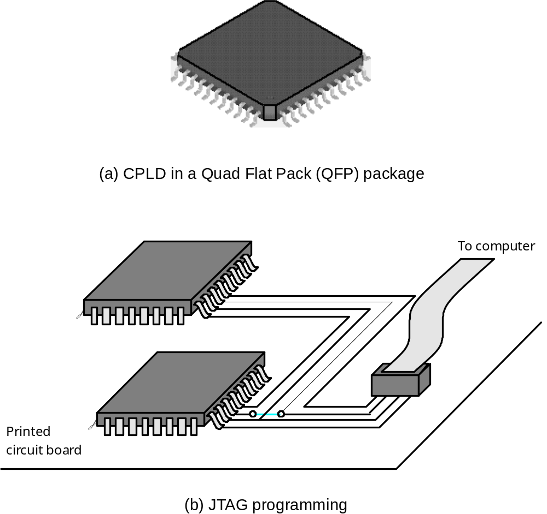
Figure 3.34. CPLD packaging and programming.
3 - Implementation Tech
Portions © Copyright 2009, S. Brown and Z Vranesic

Slide 35
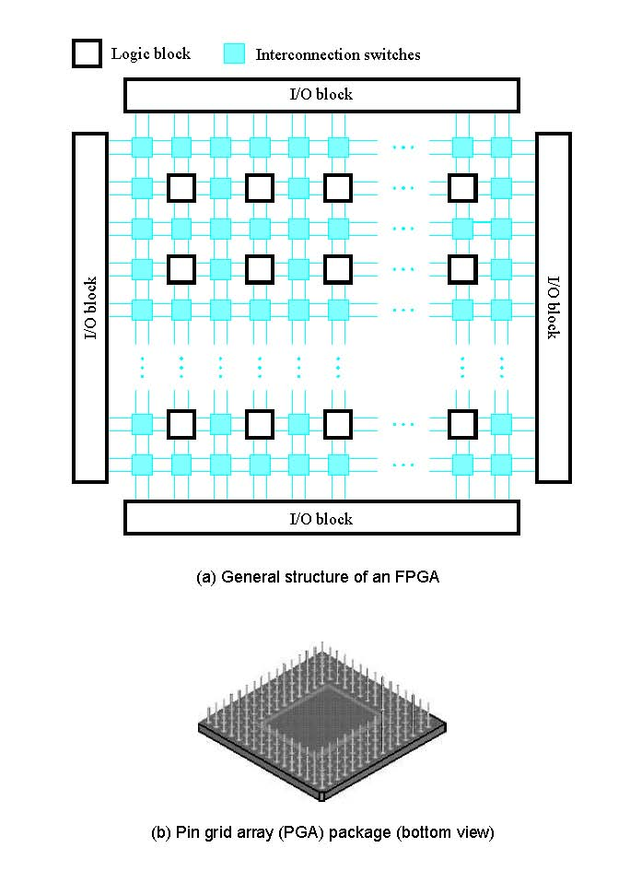
Figure 3.35. A field-programmable gate array (FPGA).
3 - Implementation Tech
Portions © Copyright 2009, S. Brown and Z Vranesic

Slide 36
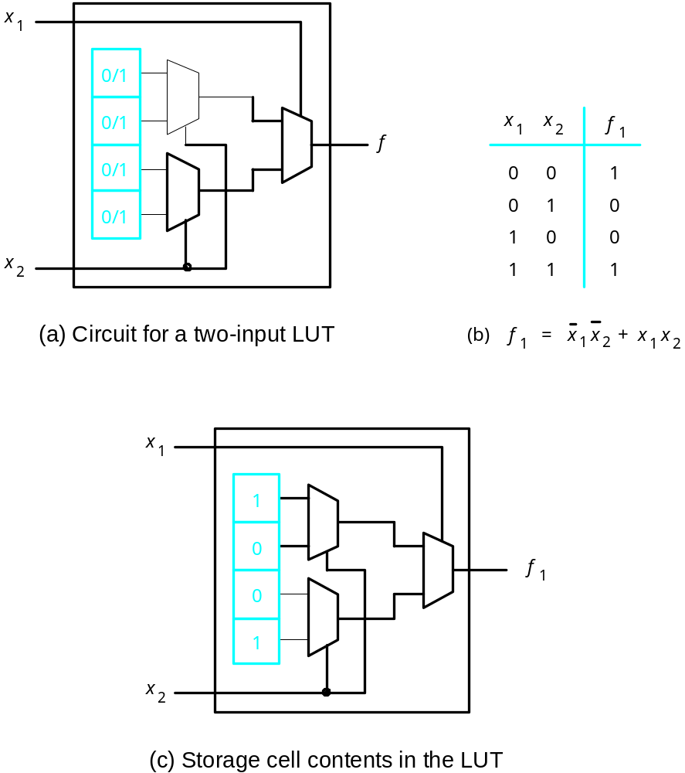
Figure 3.36. A two-input lookup table (LUT).
3 - Implementation Tech
Portions © Copyright 2009, S. Brown and Z Vranesic

Slide 37
x
1
x
2
0/1
0/1
0/1
0/1
f
0/1
0/1
0/1
0/1
x
3
Figure 3.37. A three-input LUT.
3 - Implementation Tech
Portions © Copyright 2009, S. Brown and Z Vranesic

Slide 38
Select
Out
Flip-flop
In
1
In
2
LUT
D
Q
In
3
Clock
Figure 3.38. Inclusion of a flip-flop in an FPGA logic block.
3 - Implementation Tech
Portions © Copyright 2009, S. Brown and Z Vranesic

Slide 39
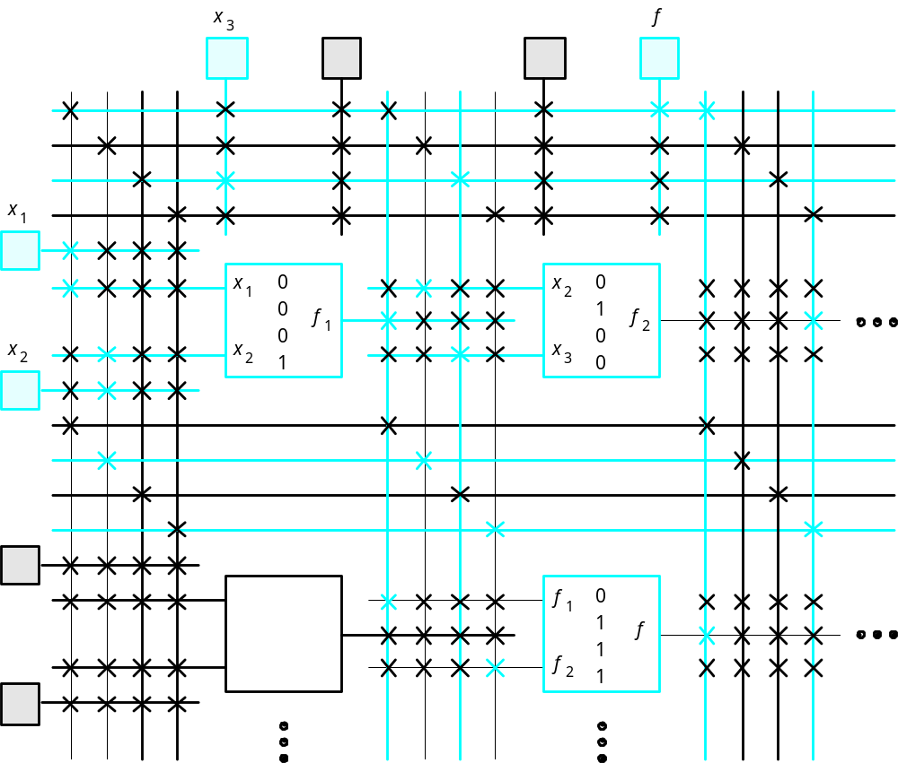
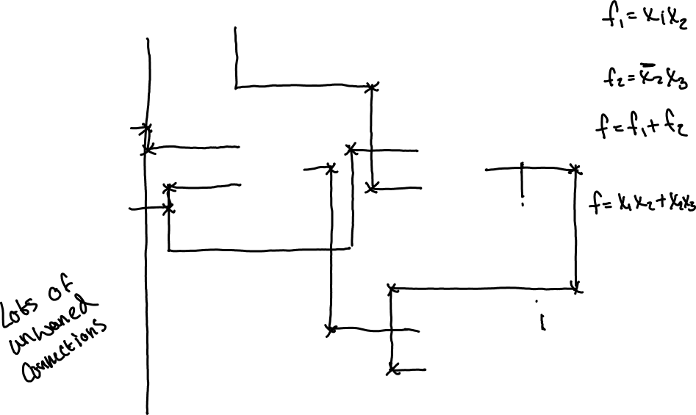
Figure 3.39. A section of a programmed FPGA.
3 - Implementation Tech
Portions © Copyright 2009, S. Brown and Z Vranesic

Slide 40
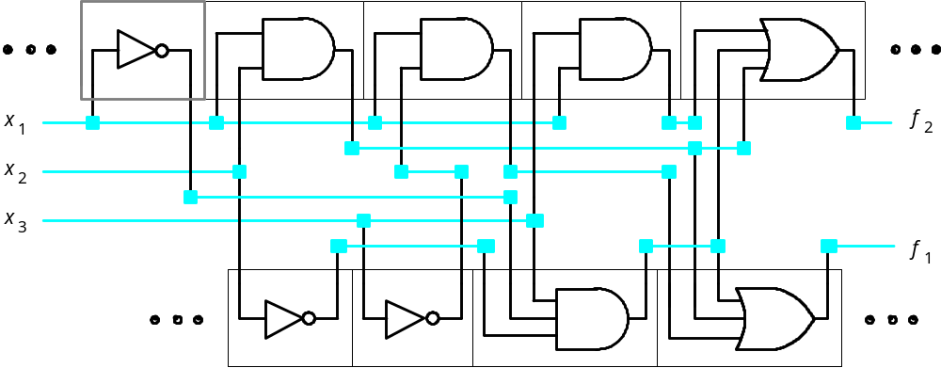
Figure 3.40. A section of two rows in a standard-cell chip.
3 - Implementation Tech
Portions © Copyright 2009, S. Brown and Z Vranesic

Slide 41
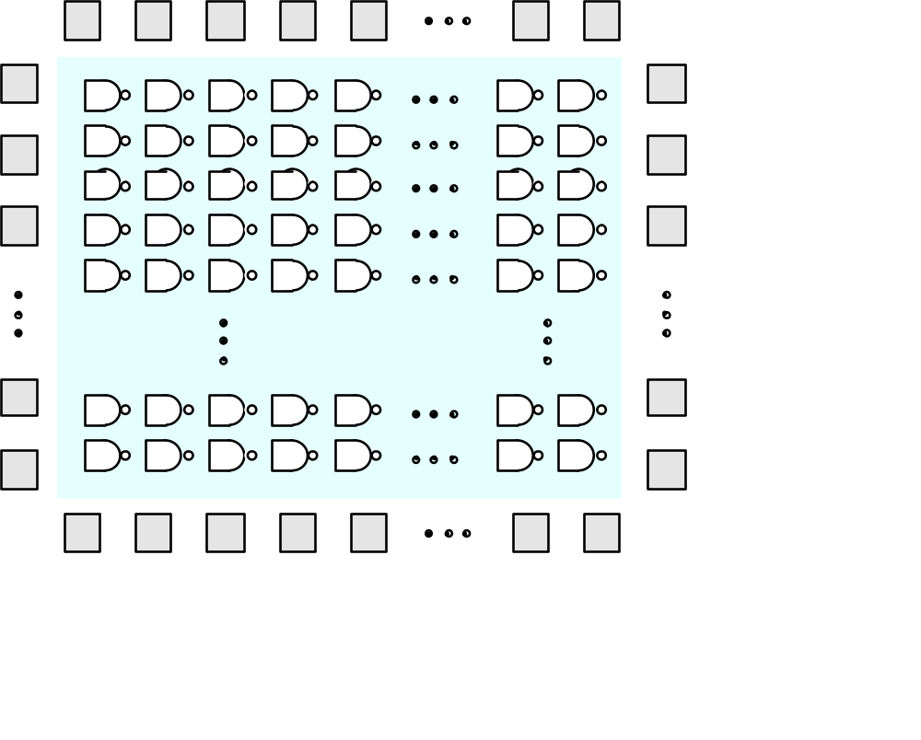
Figure 3.41. A sea-of-gates gate array.
3 - Implementation Tech
Portions © Copyright 2009, S. Brown and Z Vranesic

Slide 42
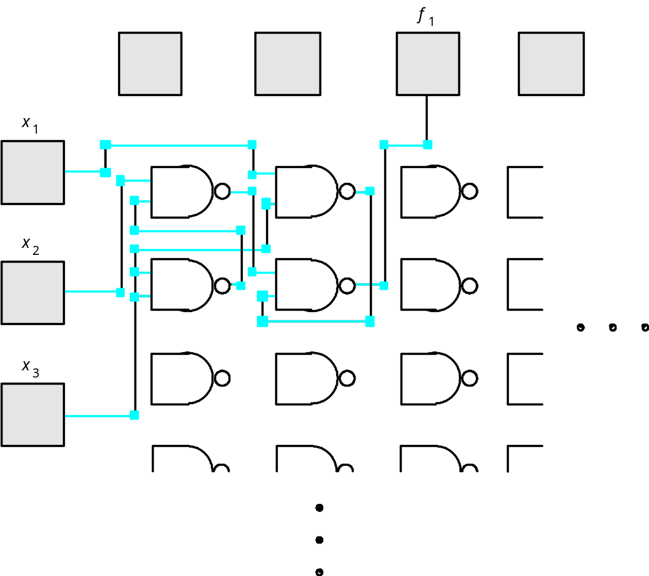
Figure 3.42. The logic function f₁ = x₂x₃+x₁x₃ in the gate array of Figure 3.41.
3 - Implementation Tech
Portions © Copyright 2009, S. Brown and Z Vranesic

Slide 43
N
1
V
f
f
To inputs of
x
To inputs of
x
other inverters
other inverters
n
n
C
n
(a) Inverter that drives
n
other inverters
(b) Equivalent circuit for timing purposes
V
f
for
n =
1
V
DD
V
f
for
n =
4
Gnd
0
Time
(c) Propagation times for different values of
n
Figure 3.55. The effect of fan-out on propagation delay.
3 - Implementation Tech
Portions © Copyright 2009, S. Brown and Z Vranesic

Slide 44
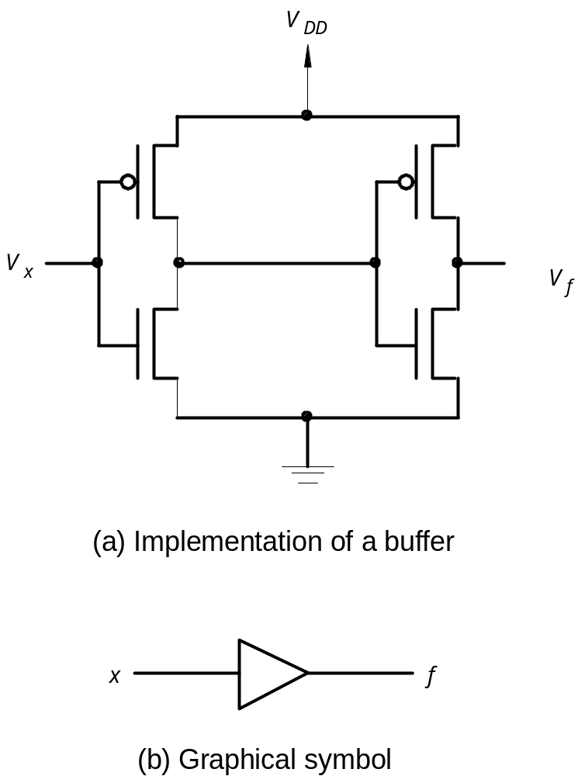
Figure 3.56. A noninverting buffer.
3 - Implementation Tech
Portions © Copyright 2009, S. Brown and Z Vranesic

Slide 45
e
= 0
e
x
f
x
f
e
= 1
x
f
(a) A tri-state buffer
(b) Equivalent circuit
e
x
f
e
0
0
Z
0
1
Z
x
1
0
0
f
1
1
1
(c) Truth table
(d) Implementation
Figure 3.57. Tri-state buffer.
3 - Implementation Tech
Portions © Copyright 2009, S. Brown and Z Vranesic

Slide 46
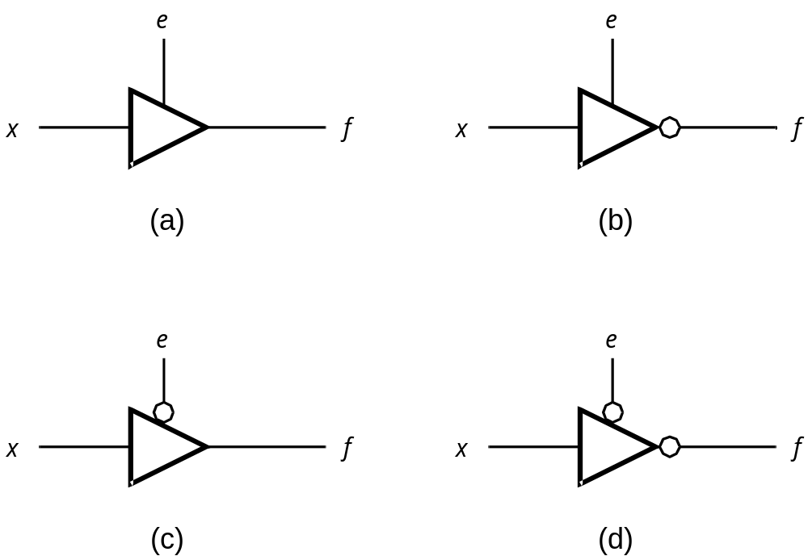
Figure 3.58. Four types of tri-state buffers.
3 - Implementation Tech
Portions © Copyright 2009, S. Brown and Z Vranesic

Slide 47
s
x
f
s
f
0
Z
1
x
s
(a) Circuit
(b) Truth table
s
=
0
x
f = Z
s
s
=
1
x
f
x
f = x
s
(c) Equivalent circuit
(d) Graphical symbol
Figure 3.60. A transmission gate.
3 - Implementation Tech
Portions © Copyright 2009, S. Brown and Z Vranesic

Slide 48
x
1
x
2
f
=
x
1
⊕
x
2
0
0
0
0
1
1
x
1
0
1
1
f
=
x
⊕
x
1
1
0
x
2
1
2
(a) Truth table
(b) Graphical symbol
x
1
x
2
f
=
x
1
⊕
x
2
(c) Sum-of-products implementation
Figure 3.61a. Exclusive-OR gate.
3 - Implementation Tech
Portions © Copyright 2009, S. Brown and Z Vranesic

Slide 49
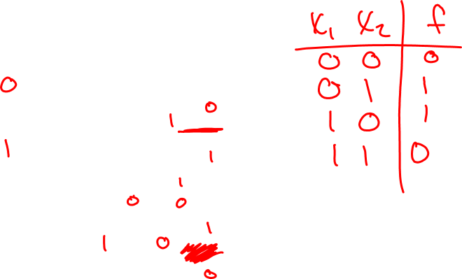
x
1
x
2
f
=
x
1
⊕
x
2
(d) CMOS implementation
Figure 3.61b. CMOS Exclusive-OR gate.
3 - Implementation Tech
Portions © Copyright 2009, S. Brown and Z Vranesic

Slide 50
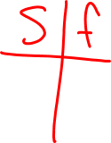
x
1
s
x
f
2
Figure 3.62. A 2-to-1 multiplexer built using transmission gates.
3 - Implementation Tech
Portions © Copyright 2009, S. Brown and Z Vranesic

Slide 51
x
1
x
2
x
3
x
4
NOR plane
V
DD
V
DD
S
1
S
2
S
3
S
4
S
5
S
6
NOR plane
f
f
Figure 3.65. Programmable version of a NOR-NOR PLA.
3 - Implementation Tech
1
2
Portions © Copyright 2009, S. Brown and Z Vranesic

Slide 52
x
1
x
2
x
3
x
4
NOR plane
V
DD
V
DD
P
1
P
2
P
3
P
4
P
5
P
6
NOR plane
Figure 3.66. A NOR-NOR PLA used for sum-of- products.
3 - Implementation Tech
f
f
Portions © Copyright 2009, S. Brown and Z Vranesic
1
2

